Slide 1

Embedded System Lecture 01: The Big Picture
Department of Computer Science and Information Engineering
Shuo-Han Chen (陳碩漢), shchen@csie.ntut.edu.tw
Hong-Yue Technology Research Building 334
R 09:10 - 12:00

Slide 2
Embedded or Not
Several key attributes are associated with embedded systems
But you would think differently under different usage of a device
For example,
You wouldn’t necessarily call your desktop PC an embedded system
But if a PC is used in a data center to perform a critical monitoring and alarm task
It fit the description we gave last week somehow
Designed for a specific task & Part of a bigger system
So, it’s really hard to determine by the hardware itself
We should also look at what it’s used for
2

Slide 3
Embedded or Not (Cont’d)
Following are some of the usual characteristics of an embedded system
Contains a processing engine, such as a general-purpose microprocessor
Typically designed for a specific application or purpose
Includes a simple (or no) user interface
Often is resource-limited. For example, it might have a small memory footprint and no hard drive
Might have power limitations, such as operating from batteries
Not typically used as a general-purpose computing platform
Generally has application software built in, not user-selected
Ships with all intended application hardware and software pre-integrated
Often is intended for applications without human intervention
3

Slide 4
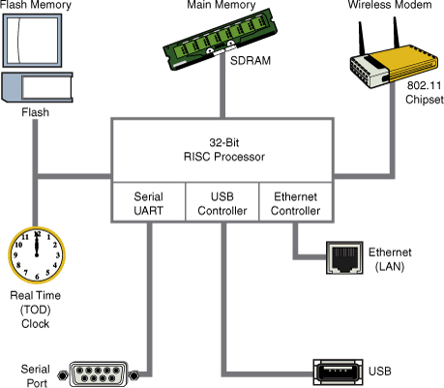
Anatomy of an Embedded System
Example of typical embedded system
32-bit RISC processor
Flash memory
SDRAM Main memory (a few megabytes to hundreds of megabytes)
Real-time clock module
4

Slide 5
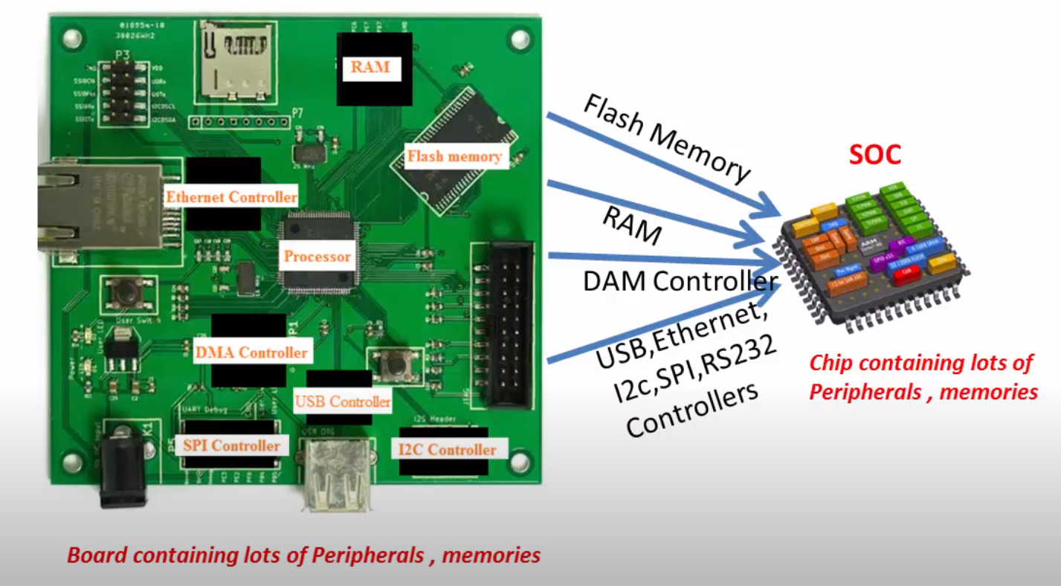
Processor vs System-on-Chip
Example
5

Slide 6
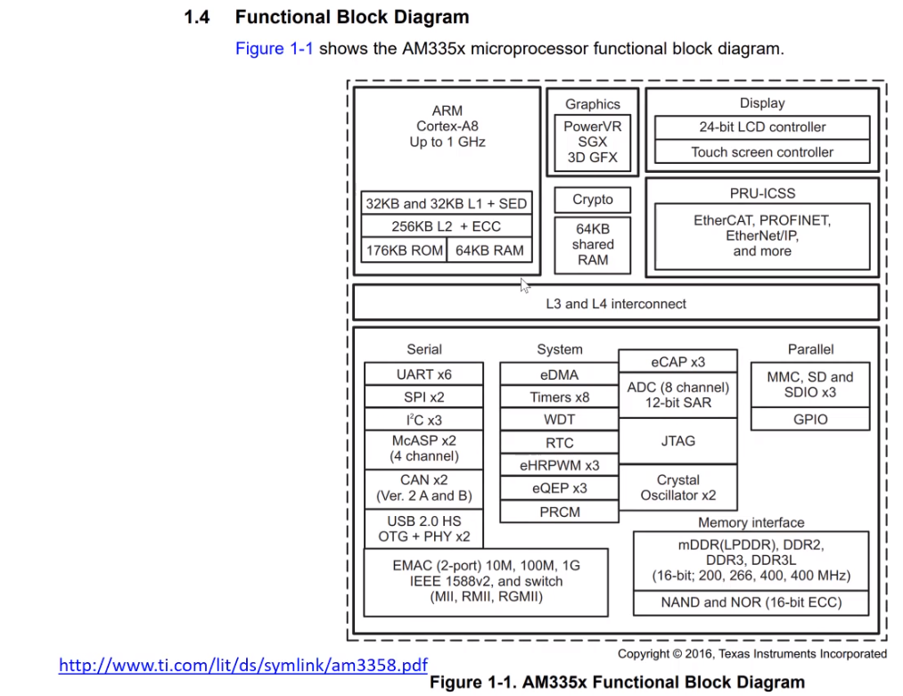
AM335x System-on-Chip
System Architecture
6

Slide 7
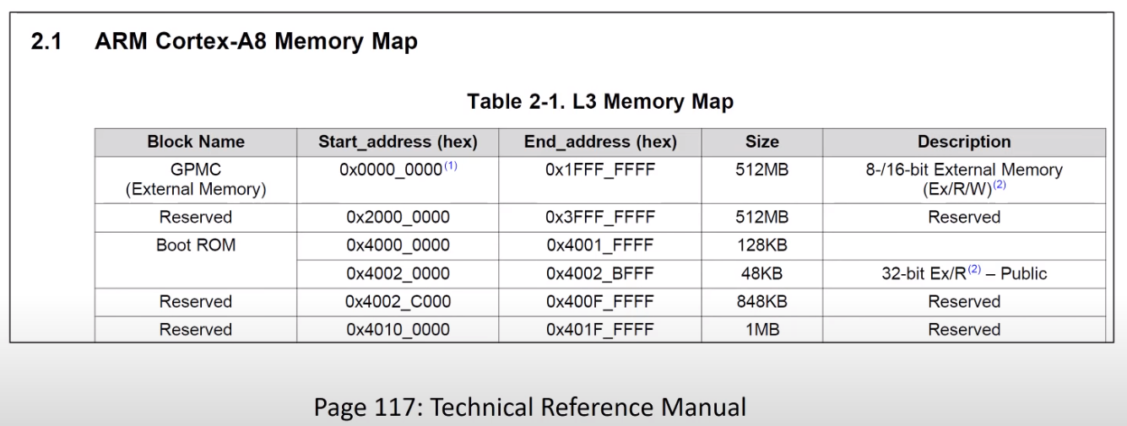
Let’s take about boot ROM
Boot ROM, where the image is stored
7

Slide 8
Let’s take about boot ROM
Boot ROM, where the image is stored
8

Slide 9
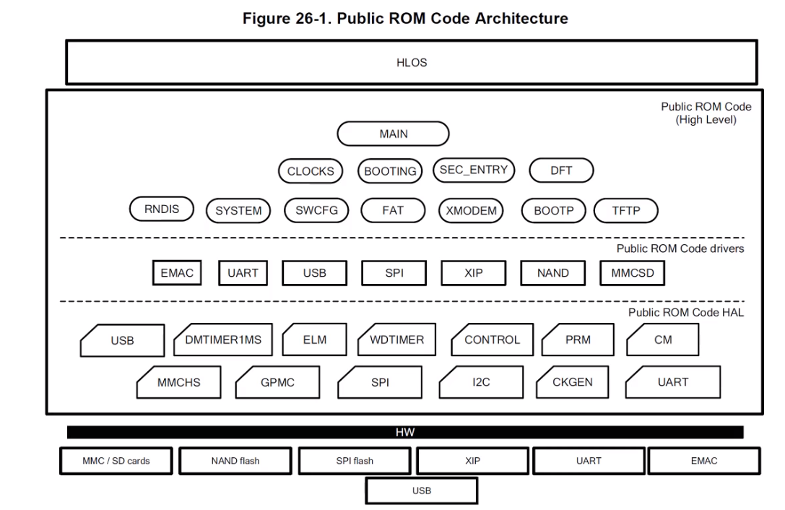
Let’s take about boot ROM
Fairly complicated with only 178 KB
9

Slide 10
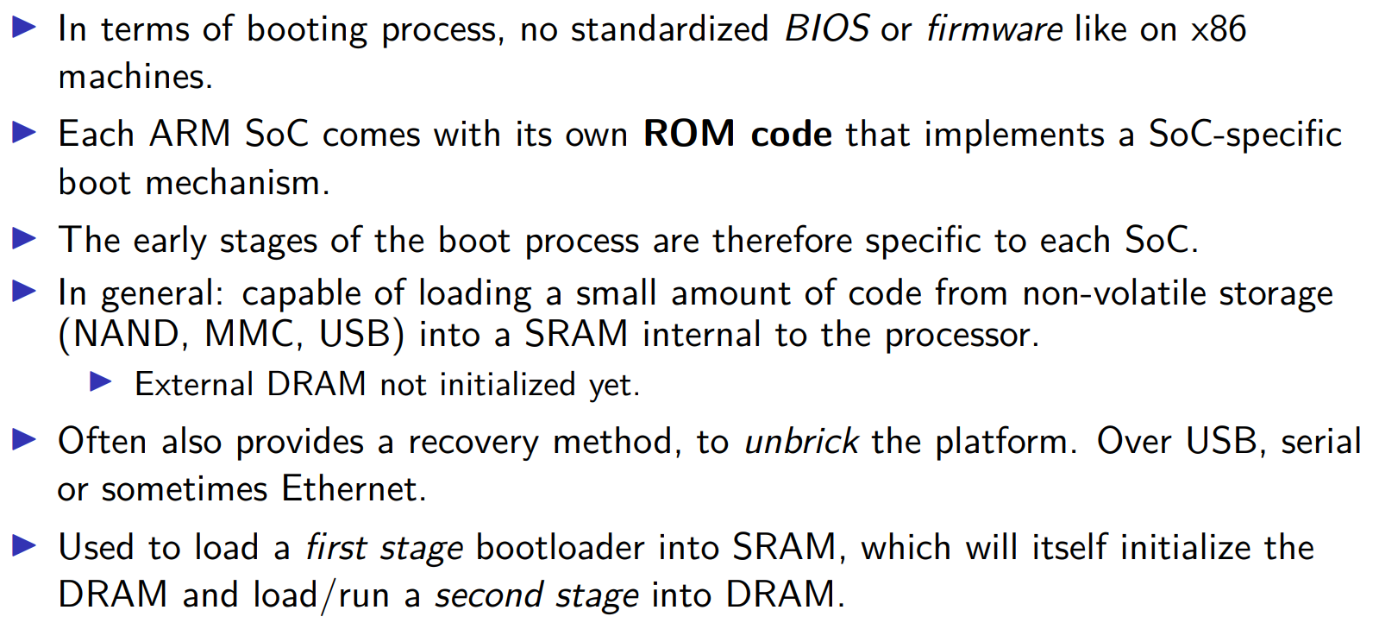
Bootloader
10

Slide 11
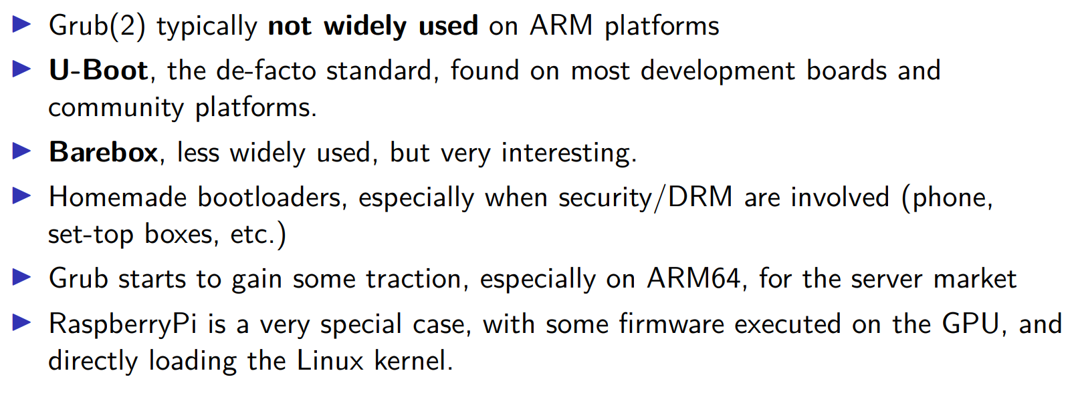
Bootloader
11

Slide 12
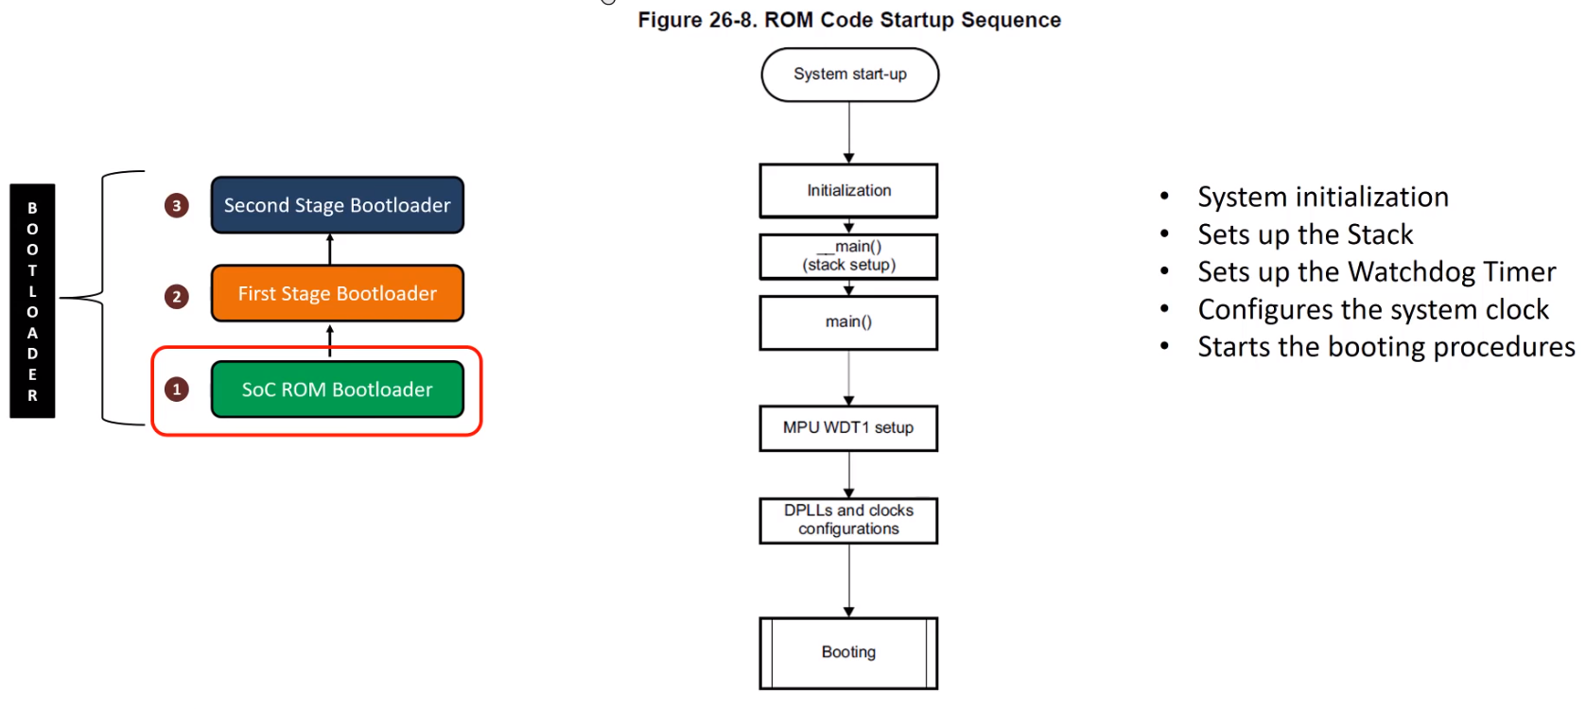
Booting Sequence
Fairly complicated with only 178 KB
12

Slide 13
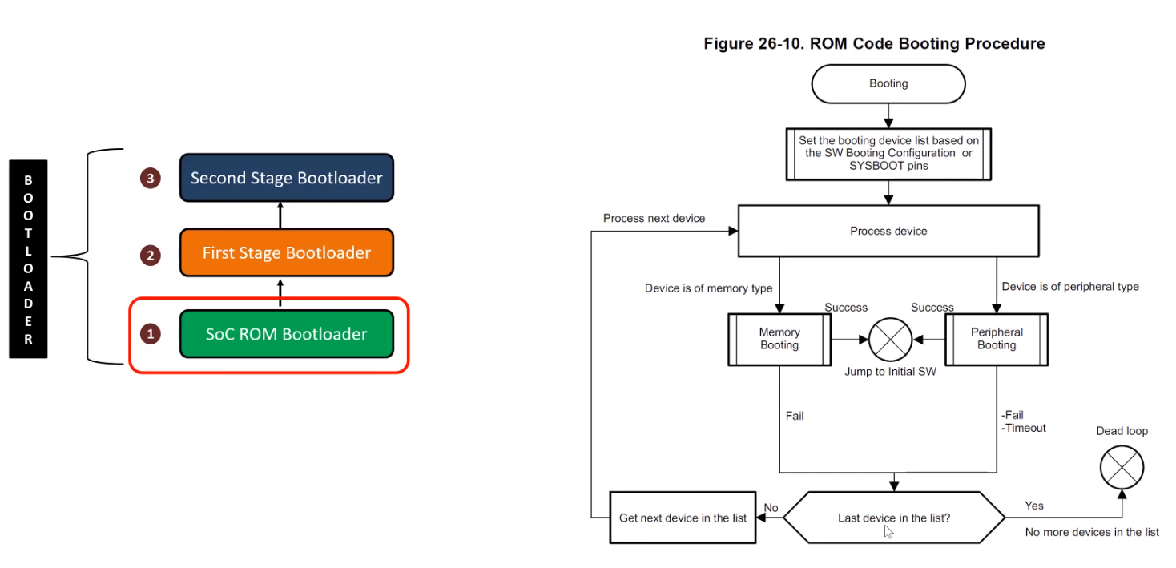
Booting Sequence
Fairly complicated with only 178 KB
13

Slide 14
Booting Sequence
Fairly complicated with only 178 KB
14

Slide 15
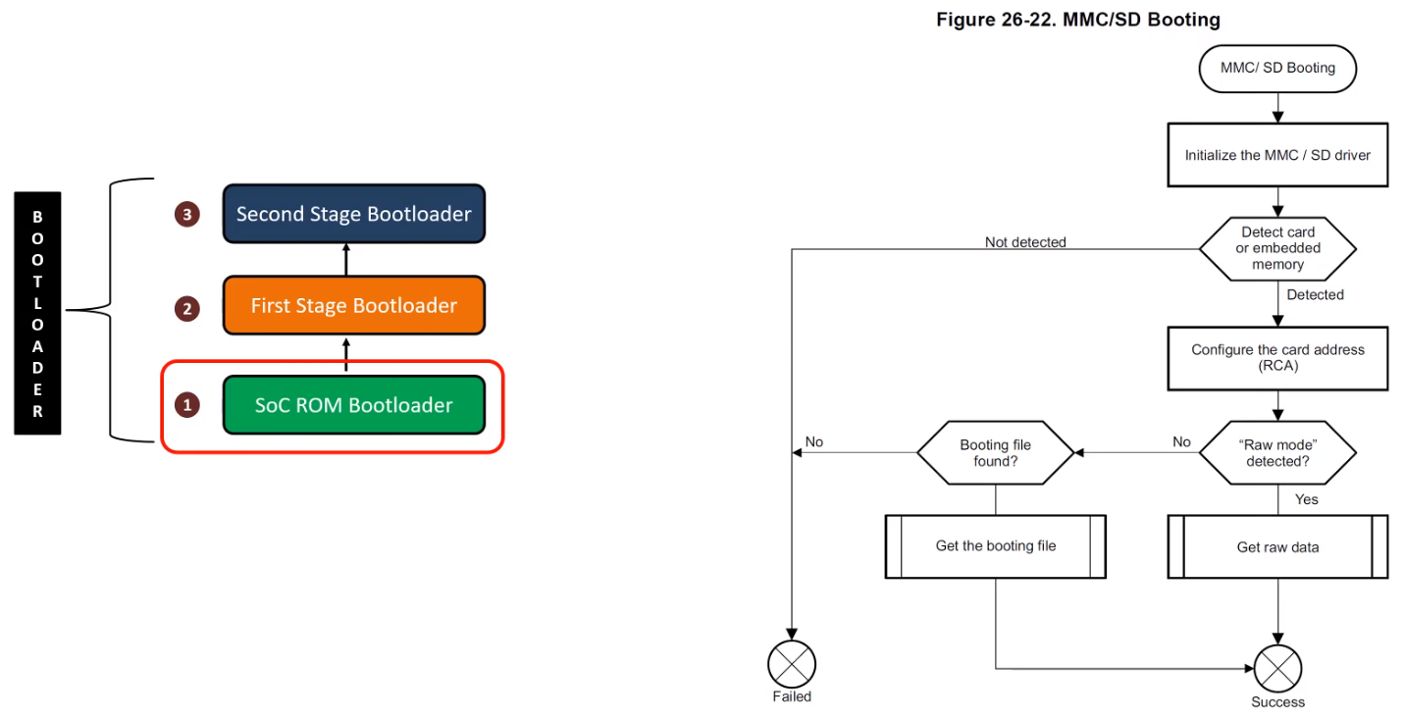
Booting Sequence
Fairly complicated with only 178 KB
15

Slide 16
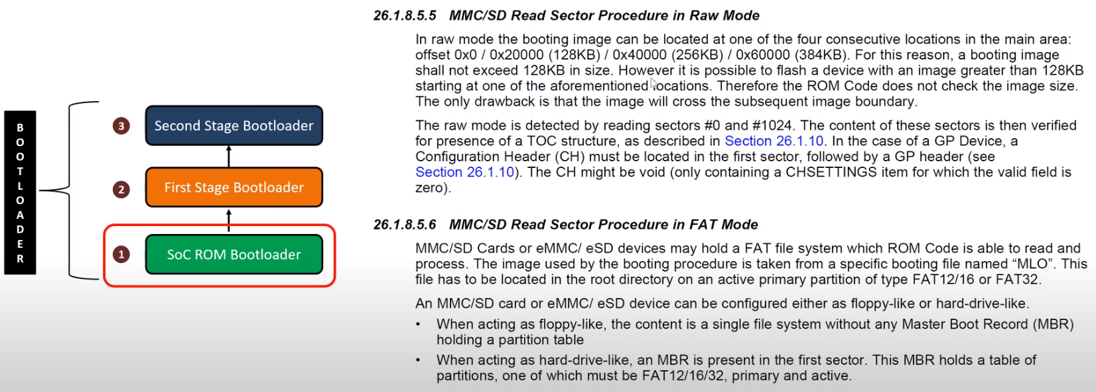
Booting Sequence
Fairly complicated with only 178 KB
16

Slide 17
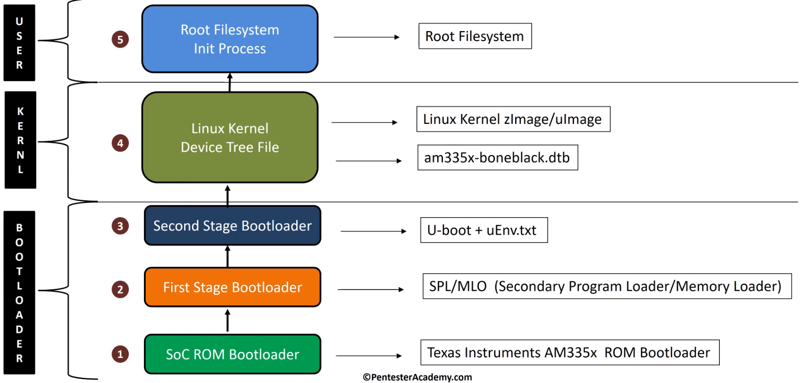
Booting Sequence
Fairly complicated with only 178 KB
17

Slide 18
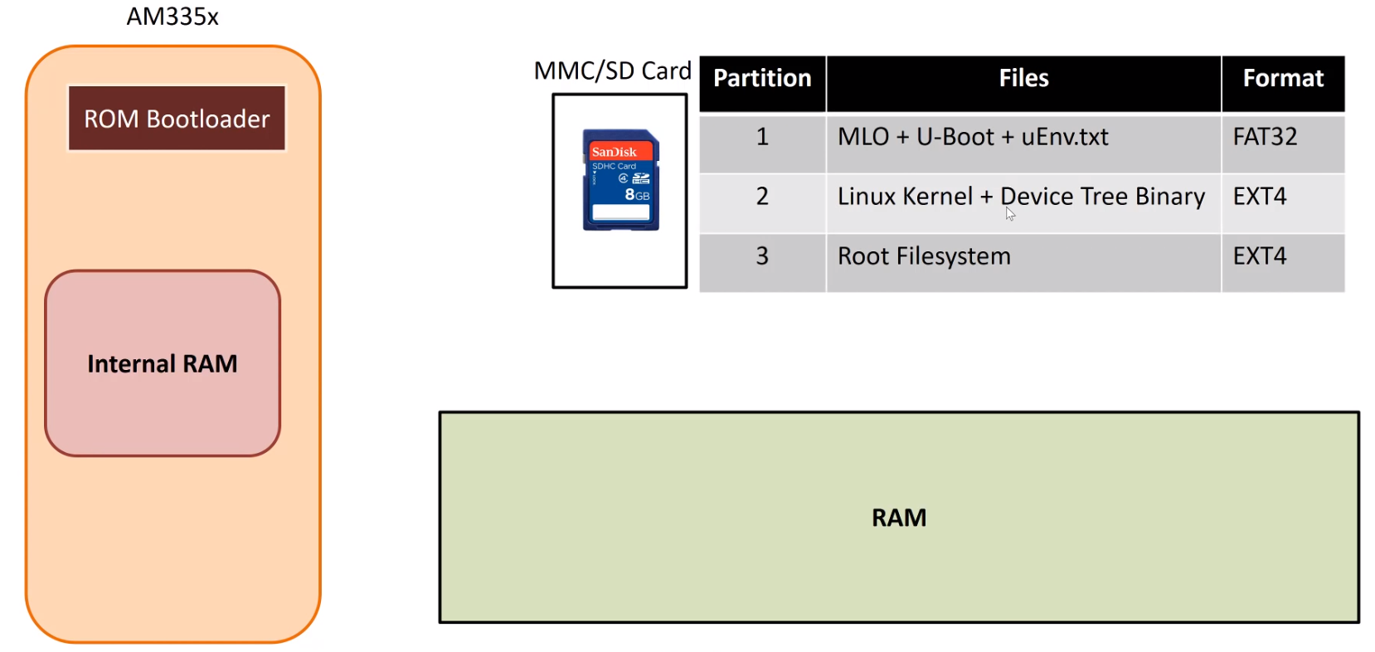
Booting Sequence
MLO
uEnv.txt
U-Boot
Init process
Boot args
Kernel
User Space Application
Device Tree Binary
18

Slide 19
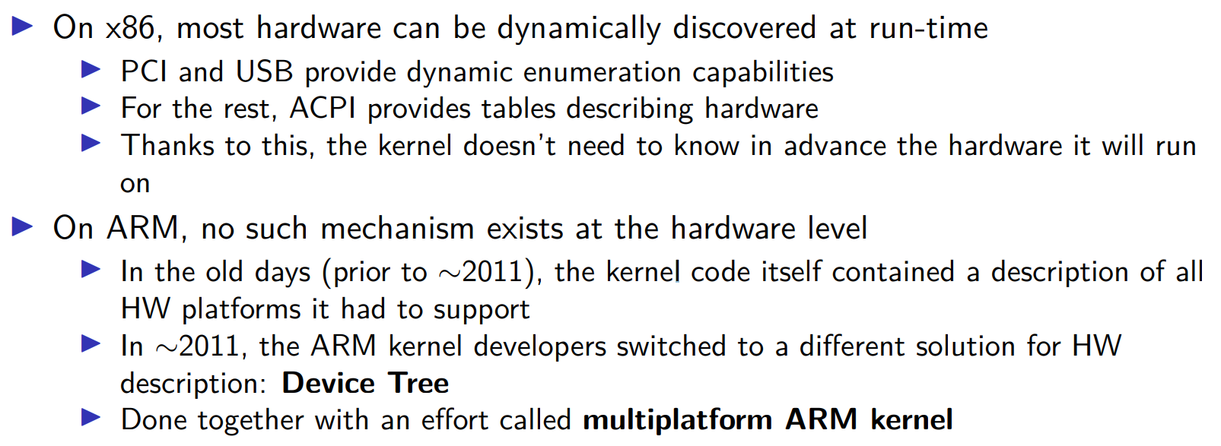
Device Tree
19

Slide 20
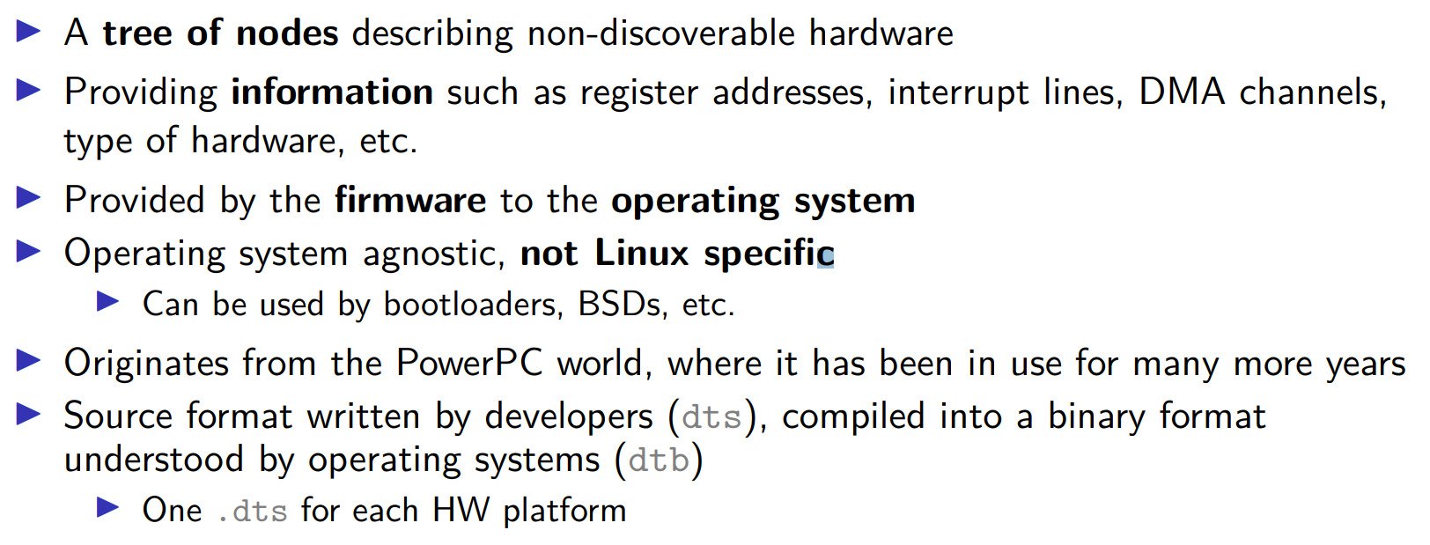
Device Tree
20

Slide 21
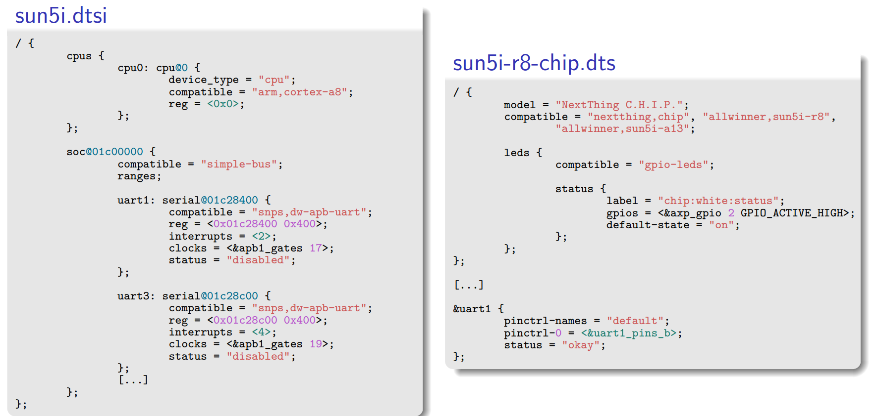
Device Tree
21

Slide 22
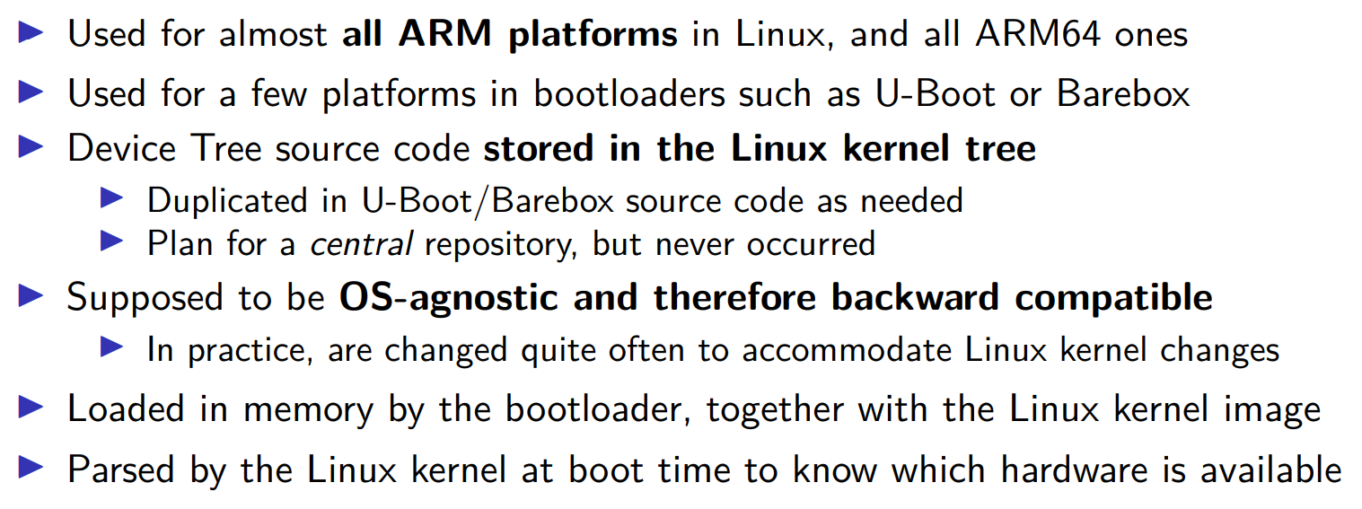
Device Tree
22

Slide 23
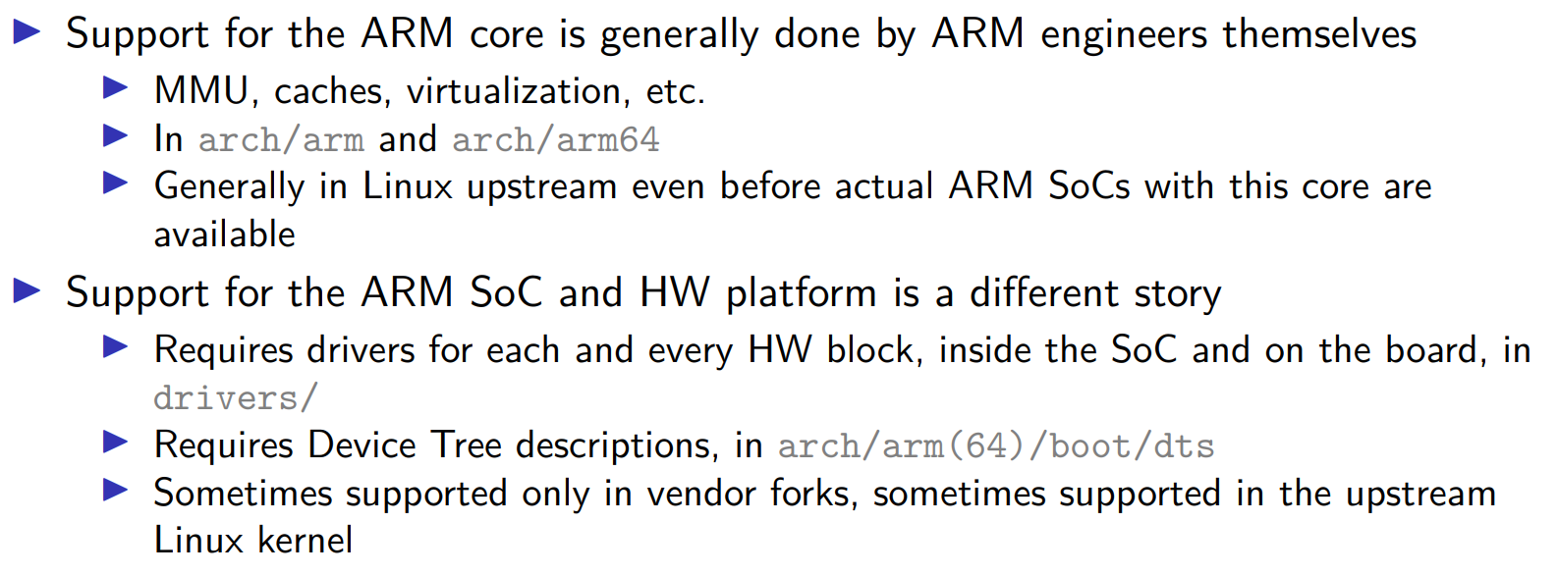
Linux Kernel
23

Slide 24
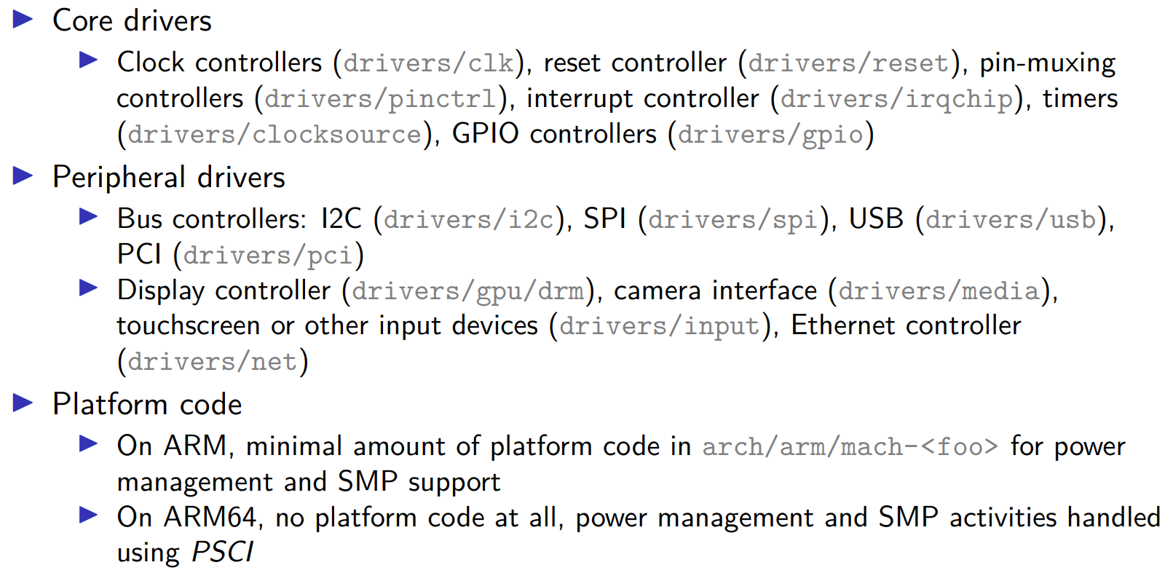
Linux Kernel : Typical Support for an SoC
24

Slide 25
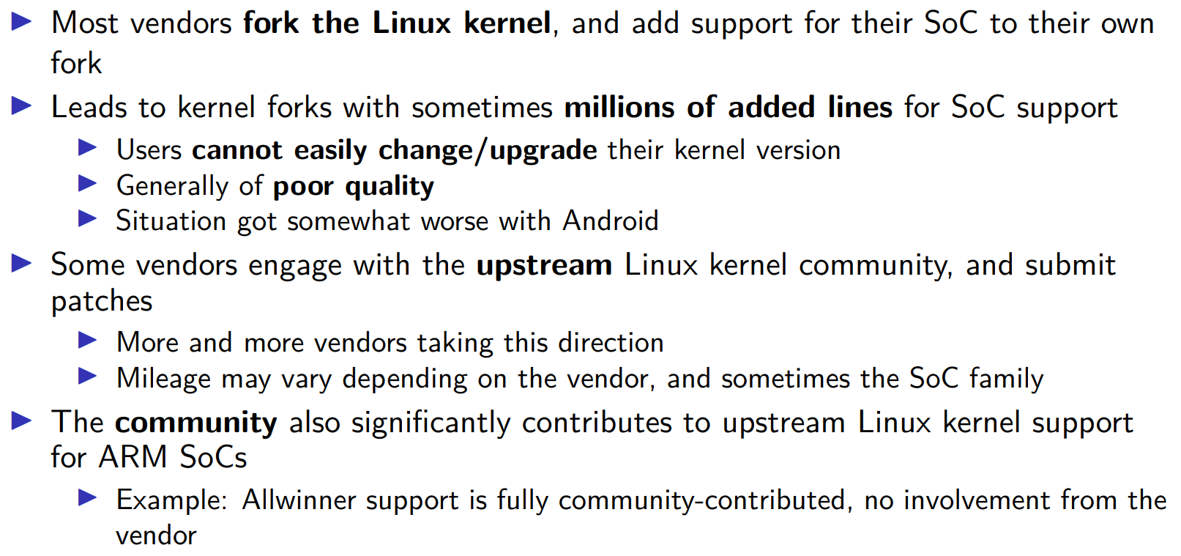
Linux Kernel : from Vendor to Upstream
25

Slide 26
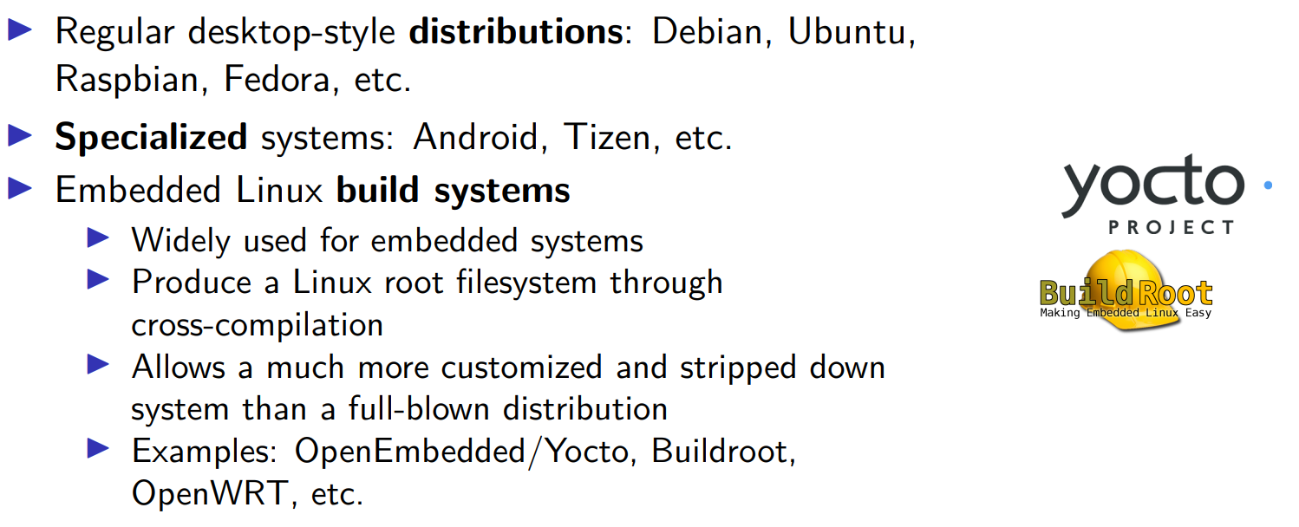
Root Filesystem
26

Slide 27
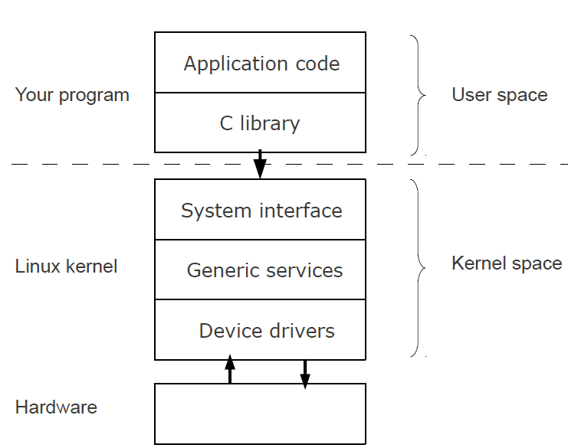
Kernel vs User Space
27

Slide 28
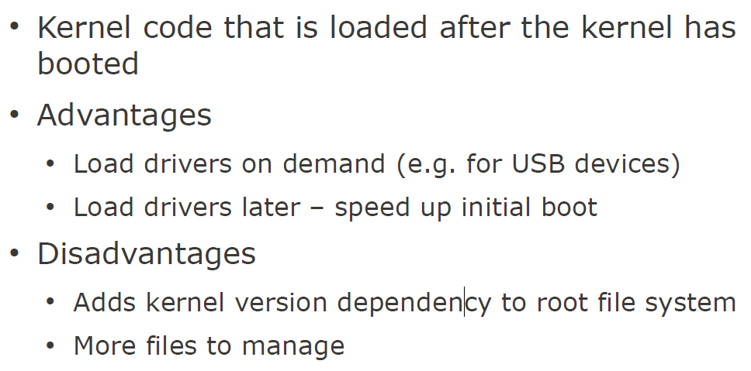
Kernel Modules
28

Slide 29
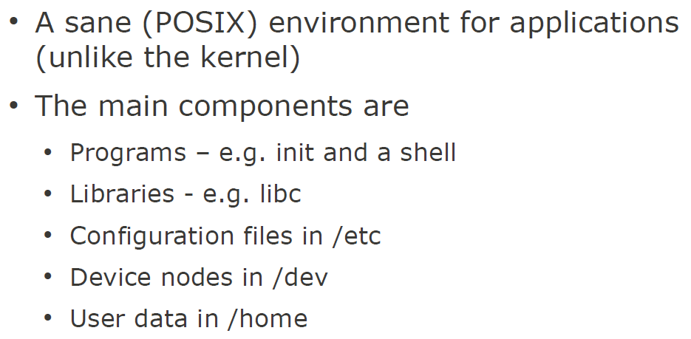
What is User Space?
29

Slide 30
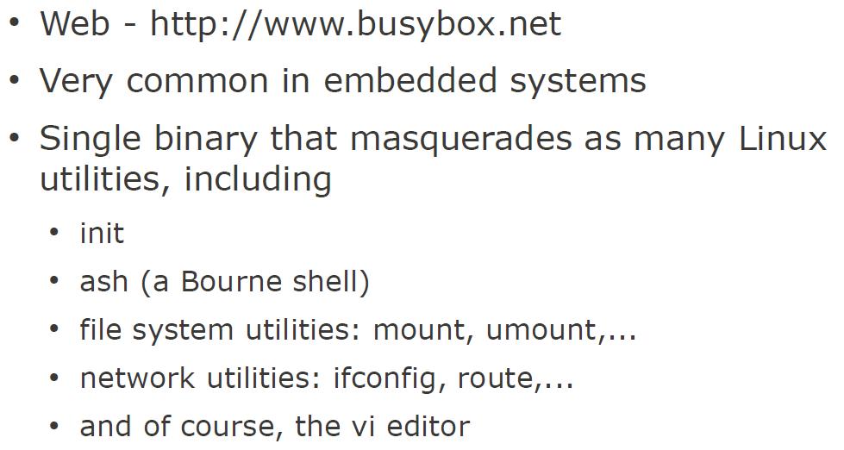
Busybox
30

Slide 31
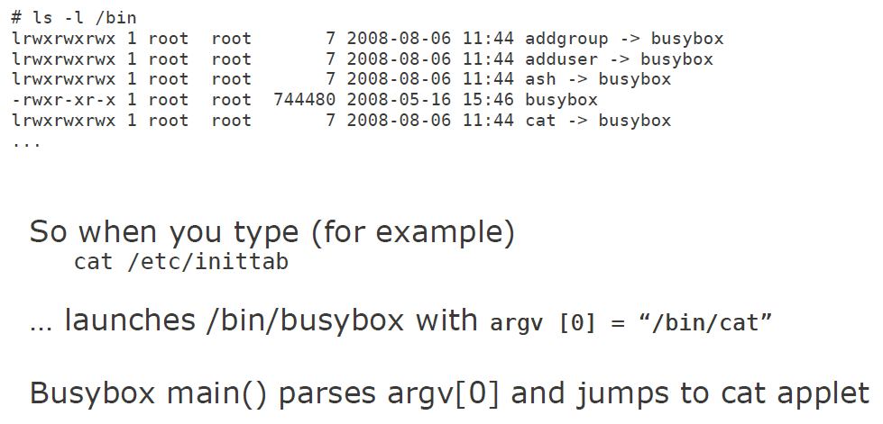
Busybox
31

Slide 32
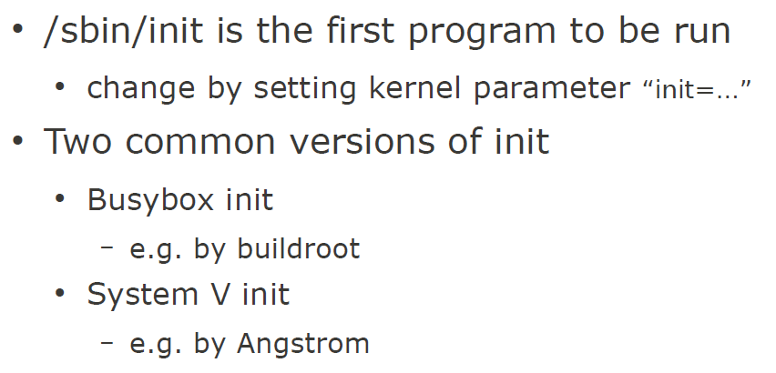
init
32

Slide 33
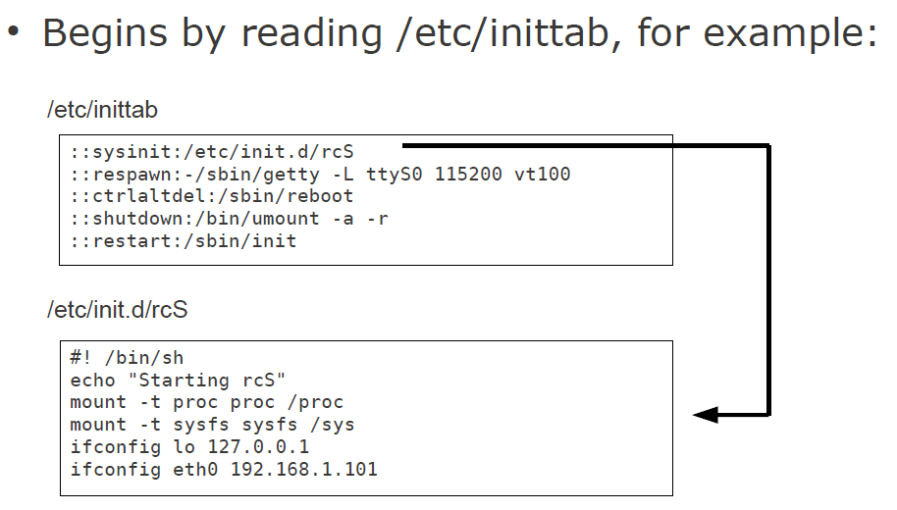
Busybox init
33

Slide 34
BIOS versus Bootloader
When power is first applied to the desktop computer, a software program called the BIOS immediately takes control of the processor
A complex set of system-configuration software routines
Have knowledge of the low-level details of the hardware architecture
Gains control of the processor when power is applied
But in typically embedded system (not x86 based), bootloader is used to initialize all components
Initializes critical hardware components, such as the SDRAM controller, I/O controllers, and graphics controllers.
Initializes system memory in preparation for passing control to the operating system.
34

Slide 35
BIOS versus Bootloader (Cont’d)
Allocates system resources such as memory and interrupt circuits to peripheral controllers, as necessary.
Provides a mechanism for locating and loading your operating system image.
Loads and passes control to the operating system, passing any required startup information. This can include total memory size, clock rates, serial port speeds, and other low-level hardware-specific configuration data.
35

Slide 36

Q & A
Thank you for your attention.
HW00 is due today and HW01 is going to be released
Notes:
Thank you for listening. Now, I would like to end today’s talk by the Q & A time.

